Slide 1
Software Defined Networking (SDN)
CS542, Fall 2016
Papers Presentation
Papers:
McKeown, Nick, et al. "OpenFlow: enabling innovation in campus networks."
ACM SIGCOMM Computer Communication Review 38.2 (2008): 69-74.
Bosshart, Pat, et al. "P4: Programming protocol-independent packet processors."
ACM SIGCOMM Computer Communication Review 44.3 (2014): 87-95.
Presented by: Syed Asif Raza Shah

Slide 2
Outline
Paper #1: "OpenFlow: enabling innovation in campus networks."
Introduction & Motivation
OpenFlow Switch
Using OpenFlow
Conclusion
Paper #2: "P4: Programming protocol-independent packet processors."
Introduction & Motivation
Abstract Forwarding Model
A Programming Language
P4 Language Example
Compiling a P4 Program
Conclusion
Discussions & Observations: Paper#1 & Paper#2

Slide 3
Paper #1: "OpenFlow: enabling innovation in campus networks.”

Slide 4
Introduction & Motivation
Current network infrastructure: enormous installed base equipments and protocols
Blessing and curse for networking researchers
Work more relevant
Impact on network innovations
Reluctance to experiment with production traffic
High barriers for new ideas
No practical way to experiment with new network protocols (new routing protocols, alternative to IP, etc)
New ideas untried and untested
Commonly held belief that network infrastructure has “ossified”
What is the solution?
“Programmable Networks”

Slide 5
Introduction & Motivation (Cont…)
Few questions are focuses:
How can we run experiments in our campus networks?
How network admin comfortable to putting experimental equipments?
How researchers control portion of network that doesn’t disturb others?
What functionality needed in network switches to enable experiments?
Commercial equipments provides an open, programmable, virtualized platform: Short-term
Typically do not provide open software platform
Narrow external interfaces (i.e. just for packet forwarding)
Internal flexibility is hidden
Few Open platform solutions exist: but insufficient performance and too expensive:
Operating system based (Linux distribution, XORP)
ATCA-based virtualized programmable router
NetFPGA
This paper proposed a new switch feature that can help extend programmability:
The OpenFlow Switch

Slide 6
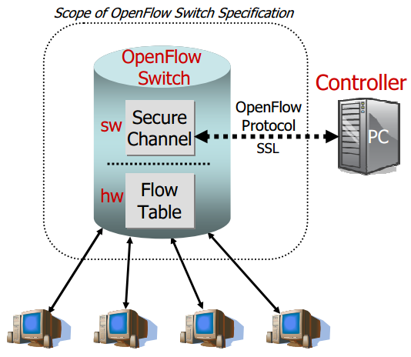
The OpenFlow Switch
Initial four goals:
High-performance & low implementation cost
Support broad range of research
Isolate traffic
Consistent with vendors’ need for closed platforms
Exploits common set of function of flow-tables of switches & routers
The OpenFlow Switch consists of three parts:
Flow Table: Action associated with flow entry to tell switch how to process the flow
Secure Channel: connect switch to remote control processor (i.e. controller)
OpenFlow protocol: provide open standard way for controller to communicate with SW
Categorized switches:
Dedicated OpenFlow switches
OpenFlow-enabled switches

Slide 7
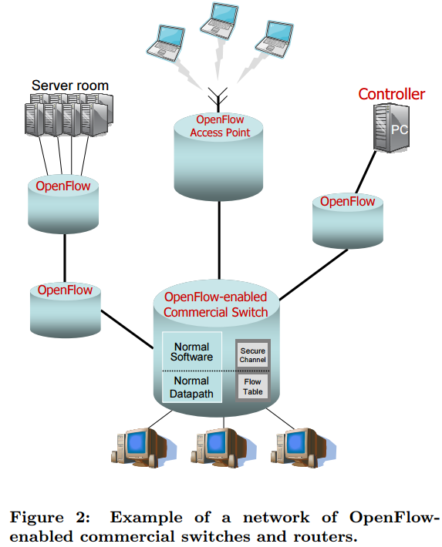
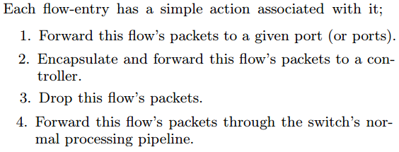
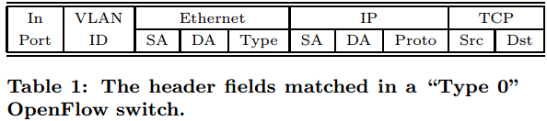
The OpenFlow Switch (Cont…)
Dedicated OpenFlow Switch:
An OpenFlow Switch is dump data-path element & just forwards packets between ports as defined by controller
An entry in Flow-Table has three fields: 1) Packet header defines flows, 2) Action, 3) Statistics
First generation dedicated OpenFlow switch “Type 0”; Flow header is 10-tuples
Open-Flow-enabled switches:
Commercial switches, routers, & APs enhanced with the OpenFlow feature by adding Flow Table

Slide 8
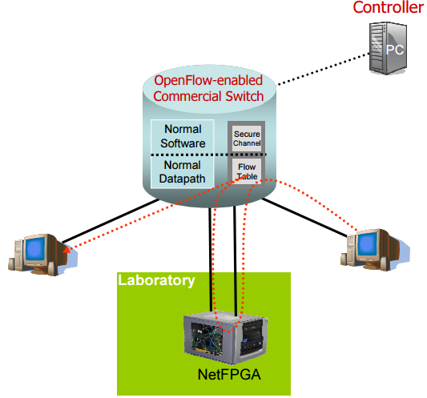
Using OpenFlow
Simple example: Amy-OSPF routing protocol replace OSPF
Amy testing new protocol in network that used by other users. Two additional properties:
Property 1: Other users packets should be routed using standard routing protocol
Property 2: Amy only add flow entries for her traffic or Net admin allowed to control
Other examples:
Network Management and Access Control: Define a network-wide policy in the central controller, which is enforced directly by making admission control decisions for each new flow.
VLAN: Traffic identified as coming from a single user (for example, originating from specific switch ports or MAC addresses) is tagged by the switches (via an action)
Mobile wireless VOIP clients: A controller is implemented to track the location of clients, re-routing connections — by reprogramming the Flow Tables
A non-IP Network: Flows could be identified using their Ethernet header
Processing Packets rather than flows: Two ways: 1) In OF-enabled network, default forwarding 2) Route traffic NetFPGA

Slide 9
Conclusion
Enables programmability in network
OpenFlow allow programming for researcher to run experiments on heterogeneous switches & routers in uniform way
OpenFlow can be implemented in dedicated OF-Switches (“Type 0”) or OF-enabled switches
Vendors don’t need to expose their internal working
It can interconnect multiple campus networks easily
It allow flexibility of network control

Slide 10
Paper #2: "P4: Programming protocol-independent packet processors."

Slide 11
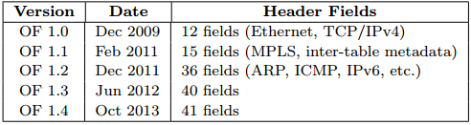
Introduction & Motivation
SDN: Control plane is physically separate from the forwarding plane
Forwarding devices could be programmed using a common, open, vendor-agnostic interface (like OpenFlow)
In the Beginning…
OpenFlow was simple
A single rule table
Priority, pattern, actions, counters, timeouts
Matching on any of 12 fields, e.g.,
MAC addresses
IP addresses
Transport protocol
Transport port numbers
Over the Past Five Years…
Proliferation of header fields
Multiple stages of heterogeneous tables
Still not enough (e.g., VXLAN, NVGRE, STT, ...)
Where does it stop?!?

Slide 12
Introduction & Motivation (Cont…)
This paper presented concept of future SDN Switches
Support flexible mechanisms for parsing packets
Configurable packet parser
Not tied to a specific header format
Flexible match+action tables
Multiple tables (in series and/or parallel)
Able to match on all defined fields
General packet-processing primitives
Copy, add, remove, and modify
For both header fields and meta-data
How?
New generation of switch ASICs
Chip designs demonstrate flexibility to achieve in custom ASICs at terabit speeds
But, programming these chips is hard
Custom, vendor-specific interfaces
Low-level, akin to microcode programming
We need a higher-level interface: To tell the switch how we want it to behave

Slide 13
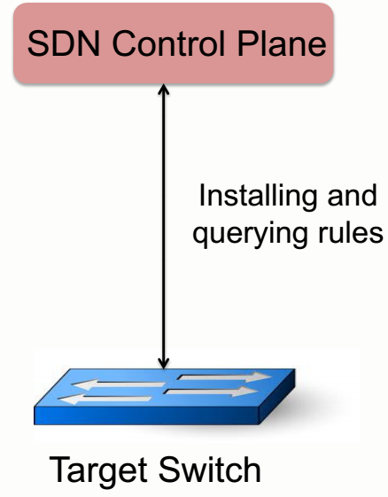
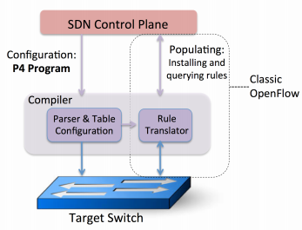
Introduction & Motivation (Cont…)
Classical OpenFlow (1.x)
Three main goals of P4:
Protocol independence
Switch should not be tied to specific packet formats
Controller should be able to specify:
A packet parser for extracting header fields with particular names and types
Define a set of typed match+action tables
Target independence
Program without knowledge of switch details
Rely on compiler to configure target switch
Reconfigurability
Change parsing and processing in the field
P4: Programming Protocol-Independent Packet Processing
OpenFlow 2.0

Slide 14
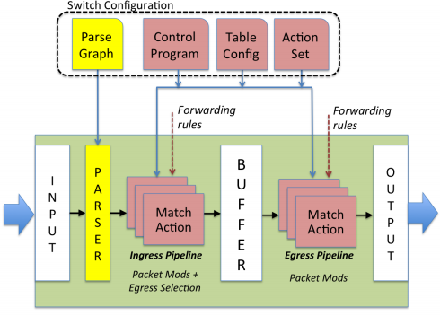
Abstract Forwarding Model
Three generalizations:
OF fixed parser; P4 support programmable parser allow new headers to be defined
OF match+actions stages in series; P4 support parallel or series
P4 model assumes that actions are composed from protocol-independent primitives
The forwarding model is controlled by two types of operations: Configure and Populate
Configure operations program the parser, set the order of match+action stages, and specify the header fields processed by each stage
Populate operations add (and remove) entries to the match+action tables

Slide 15
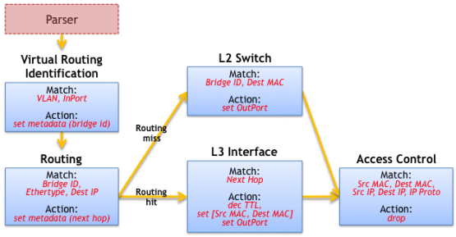
A Programming Language
Abstract forwarding model to define a language to express how a switch is to be configured and how packets are to be processed
This paper’s main goal is to propose the P4 programming language
A packet processing language must allow the programmer to express any serial dependencies between header fields
Dependencies determine which tables can be executed in parallel
Dependencies can be identified by analyzing Table Dependency Graphs (TDGs); these graphs describe the field inputs, actions, and control flow between tables.
Unfortunately TDGs are not readily accessible to most programmers
P4 is designed to make it easy to translate a P4 program into a TDG

Slide 16
P4 Concepts
Headers: A header definition describes the sequence and structure of a series of fields. It includes specification of field widths and constraints on field values.
Parsers: A parser definition specifies how to identify headers and valid header sequences within packets.
Tables: Match+action tables are the mechanism for performing packet processing. The P4 program defines the fields on which a table may match and the actions it may execute.
Actions: P4 supports construction of complex actions from simpler protocol-independent primitives.
Control Programs: The control program determines the order of match+action tables that are applied to a packet. complex actions are available within match+action tables.

Slide 17
P4 Language Example
Simple Motivating Example:
Data-center routing
Top-of-rack switches
Two tiers of core switches
Source routing by ToR
Assume end-hosts growing and core L2 tables overflowing, MPLS option can simplify the core
Hierarchical tag (mTag)
Pushed by the ToR
Four one-byte fields
Two hops up, two down

Slide 18
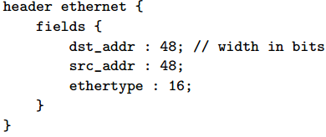
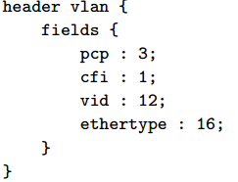
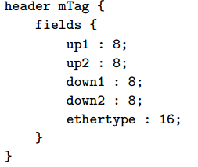
P4 Language Example: Header Formats
Header
Ordered list of fields
A field has a name and width

Slide 19
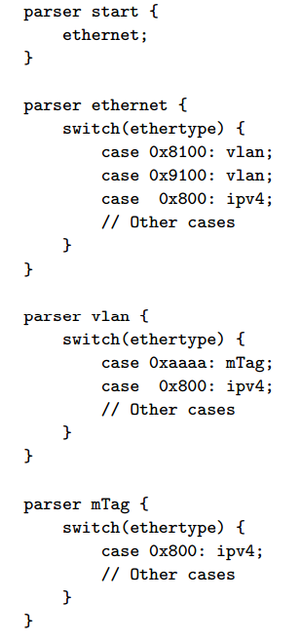
P4 Language Example: Parser
State machine traversing the packet
Extracting field values as it goes

Slide 20
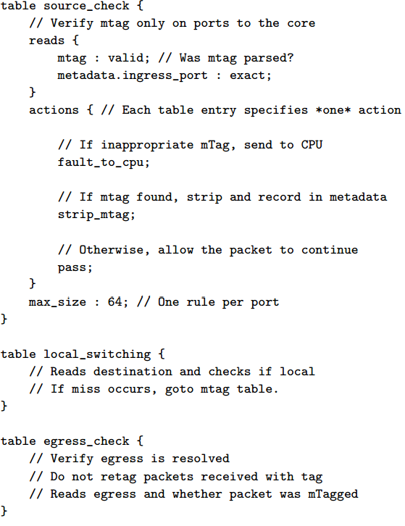
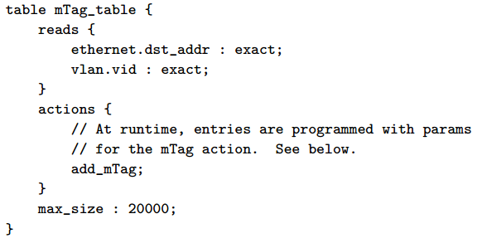
P4 Language Example: Typed Tables
Describe each packet-processing stage
What fields are matched, and in what way
What action functions are performed
(Optionally) a hint about max number of rules

Slide 21
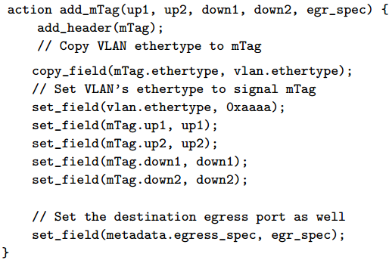
P4 Language Example: Action functions
Custom actions built from primitives
Add, remove, copy, set, increment, checksum

Slide 22
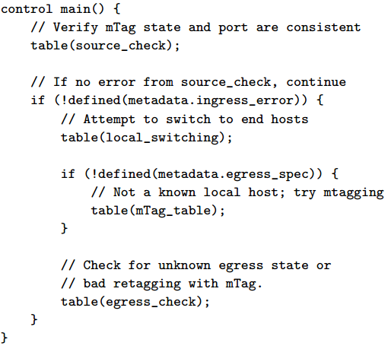
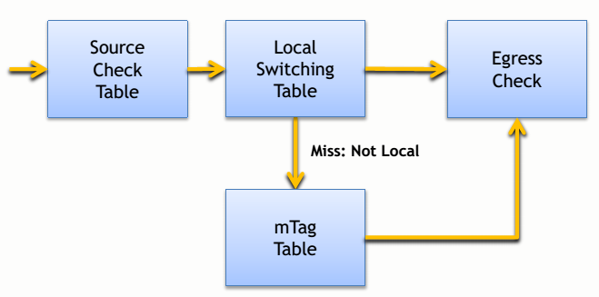
P4 Language Example: Control Flow
Flow of control from one table to the next
Collection of functions, conditionals, and tables
For a ToR switch:
Simple imperative representation

Slide 23
P4 Compiler
Parser
Programmable parser: translate to state machine
Fixed parser: verify the description is consistent
Control program
Target-independent: table graph of dependencies
Target-dependent: mapping to switch resources
Rule translation
Verify that rules agree with the (logical) table types
Translate the rules to the physical tables

Slide 24
P4 Compiler: Compiling to Target Switches
Software switches
Directly map the table graph to switch tables
Use data structure for exact/prefix/ternary match
Hardware switches with RAM and TCAM
RAM: hash table for tables with exact match
TCAM: for tables with wildcards in the match
Switches with parallel tables
Analyze table graph for possible concurrency
Applying actions at the end of pipeline
Instantiate tables that generate meta-data
Use meta-data to perform actions at the end
Switches with a few physical tables
Map multiple logical tables to a physical table
“Compose” rules from multiple logical tables into “cross product” of rules in physical table

Slide 25
Conclusion
OpenFlow 1.x
Vendor-agnostic API
But, only for fixed-function switches
An alternate future
Protocol independence
Target independence
Reconfigurability in the field
P4 language: a straw-man proposal
To trigger discussion and debate
Much, much more work to do!

Slide 26
Discussions & Observations: Paper#1
Our Observations (Performance, Scalability, Efficiency & Security):
Scalability: How many flows can the flow table handle? How a centralized controller is fast enough to install new flows on switches? How many network devices a centralized controller dynamically manage? Single-point of Failure?
Efficiency issues as the resources are shared by the research traffic and production traffic?
When a router or switch fails, how does the network behaves? How does the controller get informed about the loss of a router?
This paper also doesn’t consider security. If the rules are not configuring correctly or there exist malicious hosts, parallel traffics may influence each other.
The header fields defined in this paper are very limited. What if we want to more combination?
Skills required for OpenFlow configuration in switches and routers? How much complexity will be increases for network administrators?

Slide 27
Discussions & Observations: Paper#2
Our Observations:
I think making the compiler is really important part and it can bring many bad results like high latency, overhead of switches and so on.
I wonder if the P4 language and compiler really will not require version-up like OpenFlow 1.x.
Compatibility issue?
Just suggested the direction that’s needed for “flexible parsing, flexible actions, and flexible flow control through flexible tables. Why not we should have to think about a generalized framework?
The heterogeneous nature of the switch environment also makes it tough to develop one API to suit everyone.
What is the current status for implementing this in hardware and determining how it stacks up against current OpenFlow switches? Performance? Discourage people from using it.
What if we create intent-driven approach which can provides generalized and abstracted policy semantics for packet processing instead of programming?
Instead of hardwired packet processing pipeline in an ASIC, The more flexible choice is a network processor, where one of many cores is assigned to actually run code for a given packet.

